Slide 1
CSCE 3600 Principles of Systems Programming Python
University of North Texas

Slide 2

Python Basics

Slide 3

Using Python
Python can be executed interactively or via a script
which python
python –V
python -h
Put a shebang into a Python script to indicate
This module can be run as a script
Whether it can be run only on python2, python3, or if it is Python 2/3 compatible
On POSIX, it is necessary if you want to run the script directly without invoking python executable explicitly
If write shebang manually in script, then always use
#! /usr/bin/env python

Slide 4
Python Library
Python is packaged with a large library of standard modules
String processing
Operating system interfaces
Networking
Threads
GUI
Database
Language services
Many third party modules
XML
Numeric processing
Plotting/graphics
Etc.
All of these are accessed using import
import string
…
a = string.split(x)

Slide 5
Python Structure
Modules: Python source files or C extensions
import, top-level via from, reload
Statements
Control flow
Create objects
Indentation matters – instead of {}
Objects
Everything is an object
Automatically reclaimed when no longer needed
Can find information and tutorials on Python at:
http://python.org/

Slide 6
Interactive Shell
Statements and expressions can be typed at prompt
$ python
Python 2.7.15+ (default, Oct 7 2019, 17:39:04)
[GCC 7.4.0] on linux2
Type "help", "copyright", "credits" or "license" for more information.
>>> print "Hello, world"
Hello, world
>>> x = 12**2
>>> x/2
72
>>> # this is a comment
...
Use quit() or Ctrl-D (i.e. EOF) to exit

Slide 7
Modules
When a Python program starts, it only has access to basic functions and classes
int, dict, len, sum, range, …
Modules contain additional functionality
Use import to tell Python to load a module
Example
import math
Use from math import * to remove math prefix
math.pi
math.cos(0)
math.cos(math.pi)
dir(math)
help(math)
help(math.cos)

Slide 8
Arithmetic Operators and Precedence
Arithmetic operators:
+ addition
- subtraction/negation
* multiplication
/ division (integer division)
% modulus (i.e., remainder)
** exponentiation
Precedence:
* / % ** have a higher precedence than + -
Parentheses can be used to force a certain order of evaluation
When integers and reals are mixed, result is a real number

Slide 9
Math Commands
Has useful commands for performing calculations
Command name | Description
abs(value) | absolute value
ceil(value) | rounds up
cos(value) | cosine, in radians
floor(value) | rounds down
log(value) | logarithm, base e
log10(value) | logarithm, base 10
max(value1, value2) | larger of two values
min(value1, value2) | smaller of two values
round(value) | nearest whole number
sin(value) | sine, in radians
sqrt(value) | square root
Constant | Description
e | 2.7182818...
pi | 3.1415926...
from math import *

Slide 10
Variables
Assignment statement
Syntax: name = value
Examples
x = 5
gpa = 3.14
y = 4 << 3
z = y * 4.5
w = (y+z)/2.5
x = "Hello World"
Variables are dynamically typed (no explicit typing, types may change during execution)
Variables are just names for an object (not tied to a memory location like in C)

Slide 11
Print
print produces text output on the terminal
print "Message"
print Expression
print Item1, Item2, …, ItemN
Prints several messages and/or expressions on same line
Examples
print "Hello, world!”
age = 20
print "Only", 65 - age, ”years until retirement"
Prints given text message or expression value to terminal and moves cursor down to next line

Slide 12
Reading Input
input reads a number from user input
You can assign/store the result of input into a variable
Example
age = input("How old are you? ")
print "Your age is", age
print "Only", 65 - age, "years until retirement"
raw_input reads a string of text from user input
Example
name = raw_input("Hello, what is your name? ")
print "Good afternoon,", name

Slide 13
The for Loop
The for loop repeats set of statements over group of values
Syntax: for varName in groupOfValues:
statements
Indent statements to be repeated with spaces/tabs
varName assigns name to each value, refer in statements
groupOfValues can be range of integers, specified with range function
Example
for x in range(1, 6):
print x, "squared is", x * x
range(start, stop, [step])
inclusive
exclusive

Slide 14
Text Processing
The for loop can be used in text processing
Examine each character in a string in sequence
Example
# print characters one at a time
for c in "text":
print c
Indentation is used to denote bodies (i.e., blocks)

Slide 15
Control Flow
Things that are true
The Boolean value true
All non-zero numbers
Any string containing at least one character
A non-empty data structure
Things that are false
The Boolean value false
The numbers 0 (integer), 0.0 (float) and 0j (complex)
The empty string ""
The empty list [], empty dictionary {}, and empty set set()
You can terminate a Python script using the built-in functions quit() or exit()

Slide 16
The if Statement
The if statement executes a group of statements only if a certain condition is true
Otherwise, the statements are skipped
Syntax: if condition:
statements
Example
gpa = 3.4
if gpa > 2.0:
print "Your application is accepted."

Slide 17
The if-elif-else Statement
Syntax: if condition:
statements
elif condition:
statements
else:
statements
Example
gpa = 1.4
if gpa > 3.0:
print("Welcome to UNT!“)
elif gpa > 2.0 and gpa < 3.0:
print “Provisional welcome to UNT!"
else:
print "Your application is denied."
There is no switch statement
optional
pass is used to denote an empty body

Slide 18
The while Loop
The while loop executes a group of statements as long as a condition is true
Good for indefinite loops (repeat an unknown number of times)
Syntax: while condition:
statements
Example
num = 1
while num < 50:
print num,
num = num *2
break and continue can be used just like in C/C++

Slide 19
Logic
Many logical expressions use relational operators
Logical expressions can be combined with logical operators
Operator | Meaning | Example | Result
== | equals | 1 + 1 == 2 | True
!= | does not equal | 3.2 != 2.5 | True
< | less than | 10 < 5 | False
> | greater than | 10 > 5 | True
<= | less than or equal to | 126 <= 100 | False
>= | greater than or equal to | 5.0 >= 5.0 | True
Operator | Example | Result
and | 9 != 6 and 2 < 3 | True
or | 2 == 3 or -1 < 5 | True
not | not 7 > 0 | False

Slide 20
Strings
A sequence text characters in a program
Strings start & end with quotation mark " or apostrophe ' characters
Examples
"hello"
"This is also a string"
May not span across multiple lines or contain a " character
"This is not
a legal string."
A string can represent characters by preceding them with a \
\t tab character \n new line character
\" quotation mark character \\ backslash character
Example
print "Hello\tthere\nHow are you?"

Slide 21
String Indexes
Characters in a string are numbered with indices starting at 0
Example
"Mr. Hall"
Accessing an individual character of a string
varName[index]
Example
print name, "starts with", name[0]
index | 0 | 1 | 2 | 3 | 4 | 5 | 6 | 7
character | M | r | . |  | H | a | l | l

Slide 22
String Properties
len(string) number of characters in a string
str.lower(string) lowercase version of a string
str.upper(string) uppercase version of a string
Examples
name = "Martin Douglas Stepp"
length = len(name)
big_name = str.upper(name)
print big_name, "has", length, "characters"

Slide 23
String Operations find and split
string.find(substring)
Find start of a substring
Can also use string.find(substring, pos) to start looking at position pos
string.split(substring)
Split string into parts with substring delimiter
Examples
greeting = "hello there"
greeting.find("e")
greeting.find("e", 3)
greeting.split(" ")

Slide 24
Strings are Read Only
>>> str = "andrew"
>>> str[0] = "A"
Traceback (most recent call last):
File "<stdin>", line 1, in <module>
TypeError: 'str' object does not support item assignment
>>> str = "A" + str[1:]
>>> print str
Andrew

Slide 25
Strings and Numbers
ord(string) converts a string into a number
Example
ord("a") is 97, ord("A") is 65
chr(number) converts a number into a string
Example
chr(99) is "c"
In Python, A traceback is a report containing the function calls made in your code at a specific point i.e when you get an error it is recommended that you should trace it backward(traceback). Whenever the code gets an exception, the traceback will give the information about what went wrong in the code.

Slide 26
Lists
A compound data type:
[0]
[2.3, 4.5]
[5, "Hello", "there", 9.8]
[]
Use len() to get the length of a list
Example
names = ["Sarah", "Claire", "Michael"]
len(names)
Use [] to index items in the list
Can use negative values (i.e., relative traceback) to move backwards from the last element

Slide 27
More Lists
Append an element
names.append("Ben")
Remove an element by extending the list
del names[1]
Sort by default order
names.sort()
Reverse the elements in the list
names.reverse()
Insert an element at some specified position
names.insert(1, "Jorge")

Slide 28
Files
The open() function
f = open("file1", "w") # open file for writing
g = open("file2", "r") # open file for reading
Reading and writing data
f.write("Hello World")
data = g.read() # read all data
line = g.readline() # read a single line
lines = g.readlines() # read data as list of lines
Formatted I/O
Use the % operator for strings (works like C printf)
for i in range(0, 10):
f.write("2 x %d = %d\n" % (i, 2*i))

Slide 29
File Processing
Read the entire contents of a file
file_text = open("account.txt").read()
Read a line in a file
f = open("names.txt")
f.readline()
Output to a file
infile = open("names.txt")
outfile = open("out.txt", "w")
for line in infile:
outfile.write(line)
w write
a append
wb write in binary
r read (default)
rb read in binary

Slide 30
File Processing (cont’d)
Read a file line-by-line
for line in open("filename").readlines():
statements
Example
count = 0
for line in open("account.txt").readlines():
count = count + 1
print "The file contains", count, "lines."

Slide 31
Functions
Define functions in file above point used
Body of function should be indented consistently
def statement creates an object and assigns a name to reference it
Arguments are optional
Multiple arguments are separated by commas
If no return statement, then “None” is returned
Return values can be simple types (or tuples) and may be ignored by the caller
Example
def square(n):
return n*n
print("The square of 3 is", square(3))
Tuples are just values separated by commas

Slide 32
Function Example
#! /usr/bin/env python3
# print a Fibonacci series up to n
def fib(n):
a, b = 0, 1
while (b < n):
print b,
a, b = b, a+b
n = input("Enter a number: ")
fib(n)
$ python fibSeries.py
Enter a number: 100
1 1 2 3 5 8 13 21 34 55 89

Slide 33
Classes
class Classname:
statements
Example
#! /usr/bin/env python
# a simple example class
class MyClass:
i = 123
def f(self):
return "Hello World!"
print MyClass.i
x = MyClass()
print x.f()
First argument of method usually called self

Slide 34
Classes Example
class Account:
def __init__(self, initial):
self.balance = initial
def deposit(self, amt):
self.balance = self.balance + amt
def withdraw(self, amt):
self.balance = self.balance - amt
def getbalance(self):
return self.balance
a = Account(1000.00)
a.deposit(550.23)
a.deposit(100)
a.withdraw(50)
print a.getbalance()

Slide 35
Exceptions
The try statement
try:
f = open("file1.txt")
except IOError:
print "Could not open "file1.txt"
The raise statement
def factorial(n):
if n < 0:
raise ValueError, "Expected non-negative number"
if (n <= 1): return 1
else: return n*factorial(n-1)
Uncaught exception
>>> factorial(-1)
Traceback (most recent call last):
File "<stdin>", line 1, in <module>
File "<stdin>", line 3, in factorial
ValueError: Expected non-negative number
>>>

Slide 36
Operating System Services

Slide 37
Operating System Services
Python provides a wide variety of OS interfaces
Basic system calls
Operating environment
Processes
Timers
Signal handling
Error reporting
Users and passwords
Implementation
A large portion of this functionality is contained in the os module
The interface is based on POSIX
Not all functions are available on all platforms

Slide 38
Process Management
fork-exec-wait
os.fork() # create a child process
os.execv(path, args) # execute a process
os.execve(path, args, env)
os.execvp(path, args) # execute a process, use default path
os.execvpw(path, args, env)
os.wait(pid) # wait for child process
os.waitpid(pid, opts) # wait for state change of child
os.system(command) # execute system command
os._exit(n) # exit immediately with status n
Example
import os
pid = os.fork() # create child
if pid == 0:
# child process
os.execvp("ls", ["ls", "-l"])
else:
os.wait()
print "done"

Slide 39
Pipes
os.popen() function
f = popen("ls -l", "r")
data = f.read()
Print(data)
f.close()
The popen2 module
Spawns processes, provides hooks to stdin, stdout, and stderr
popen2(cmd) # run cmd, return (stdout, stdin)
popen3(cmd) # run cmd, return (stdout, stdin, stderr)
Example
…
(o, i) = popen2.popen2("wc")
i.write(data) # write to child’s input
i.close()
result = o.read() # get child’s output
print result
o.close()
Opens a pipe to or from a command and returns a file-object

Slide 40
Signal Handling
The signal module
signal.signal(signalnum, handler) # set signal handler
signal.alarm(time) # schedule SIGALRM signal
signal.pause() # go to sleep until signal
signal.getsignal(signalnum) # get signal handler
Example
import signal
interval = 1
ticks = 0
def alarm_handler(signo, frame):
global ticks
print "Alarm ", ticks
ticks = ticks + 1
signal.alarm(interval) # schedule new alarm
signal.signal(signal.SIGALRM, alarm_handler)
signal.alarm(interval)
while 1:
pass

Slide 41
Signal Handling
Ignoring signals
signal.signal(signo, signal.SIG_IGN)
Default behavior
signal.signal(signo, signal.SIG_DFL)
Comments
Signal handlers remain installed until explicitly reset
Signals are only handled between atomic instructions of interpreter
Certain signals cannot be handled from Python (e.g., SIGSEGV)
Python handles a number of signals on its own (e.g., SIGINT, SIGTERM)
Mixing signals and threads is extremely problematic – only main thread can deal with signals

Slide 42
Python Threads
Thread scheduling
Tightly controlled by a global interpreter lock and scheduler
Only a single thread is allowed to be executing in the Python interpreter at once
Thread switching only occurs between the execution of individual byte-codes
Most I/O operations do not block
Comments
Python threads are somewhat more restrictive than in C
Effectiveness may be limited on multiple CPUs (due to interpreter lock)
Threads can interact strangely with other Python modules (especially signal handling)
Not all extension modules are thread-safe

Slide 43
The Thread Module
The thread module provides low-level access to threads
Thread creation
Simple mutex locks
Creating a new thread
thread.start_new_thread(func.[args [.kwargs]])
Executes a function in a new thread
Example
import thread
import time
def print_time(delay):
while 1:
time.sleep(delay)
print time.ctime(time.time())
thread.start_new_thread(print_time, (5,))
while 1:
pass

Slide 44
The Thread Module
Thread termination
Thread silently exits when the function returns
Thread explicitly exit by calling thread.exit() or sys.exit()
Uncaught exception causes thread termination (prints error message)
Other threads continue to run even if one had an error
Simple locks
allocate_lock() creates a lock object, initially unlocked
import thread
lk = thread.allocate_lock()
def some_example():
lk.acquire() # acquire lock
critical section
lk.release() # release lock
Only one thread can acquire lock at once
Threads block indefinitely until lock becomes available

Slide 45
The Thread Module
The main thread
When Python starts, it runs as a single thread of execution
This is called the “main thread”
Termination of the main thread
If the main thread exits and other threads are active, the behavior is system dependent
Usually, this immediately terminates the execution of all other threads without cleanup
Cleanup actions of the main thread may be limited as well
Signal handling
Signals can only be caught and handled by the main thread of execution
Otherwise, you will get an error (in the signal module)
The keyboard-interrupt can be caught by any thread (non-deterministically)

Slide 46
Network Programming

Slide 47
Network Overview
Python provides a wide assortment of network support
Low-level programming with sockets
Support for existing network protocols (HTTP, FTP, SMTP, etc.)
Web programming (CGI scripting and HTTP servers)
Data encoding

Slide 48
Socket Example
The socket module
Provides access to low-level network programming functions
Example
from socket import *
import time
s = socket(AF_INET, SOCK_STREAM)
s.bind(("", 8888)) # bind to port 8888
s.listen(5) # start listening
while 1:
client,addr = s.accept() # wait for connection
print "Connection received from ", addr
client.send(time.ctime(time.time()))
client.close()
Socket first opened by server is not same one used to exchange data
Instead, accept() function returns a new socket for this client
Server returns the current time

Slide 49
Socket Example (cont’d)
Client program
Connect to time server and get current time
from socket import *
s = socket(AF_INET, SOCK_STREAM)
s.connect(("cse05.cse.unt.edu", 8888))
tm = s.recv(1024) # receive up to 1024 bytes
s.close()
print "The time is ", tm
Once connection is established, server/client communicate using send() and recv()

Slide 50
The Socket Module
Socket methods
s.accept() # accept new connection
s.bind(addr) # bind to address and port
s.close() # close socket
s.connect(addr) # connect to remote socket
s.fileno() # return file descriptor
s.getpeername() # get name of remote machine
s.getsockname() # get socket address
s.getsockopt(…) # get socket options
s.listen(backlog) # start listening for connections
s.makefile(mode) # turn socket into file-object
s.recv(bufsize) # receive data
s.recvfrom(bufsize) # receive data (UDP)
s.send(string) # send data
s.sendto(str, addr) # send packet (UDP
s.setblocking(flag) # set blocking/nonblocking mode
s.setsockopt(...) # set socket options
s.shutdown(how) # shutdown one or both connections

Slide 51
Socket Basics
To create a socket
import socket
s = socket.socket(addr_family, type)
Address families
socket.AF_UNIX Unix domain
socket.AF_INET Internet protocol (IPv4)
socket.AF_INET6 Internet protocol (IPv6)
Socket types
socket.SOCK_STREAM Connection based stream (TCP)
socket.SOCK_DGRAM Datagrams (UDP)
Example
from socket import *
s = socket(AF_INET,SOCK_STREAM)

Slide 52
TCP Server
A simple server
from socket import *
s = socket(AF_INET,SOCK_STREAM)
s.bind(("",9000))
s.listen(5)
while True:
c,a = s.accept()
print "Received connection from", a
c.send("Hello %s\n" % a[0])
c.close()
Send a message back to a client
telnet localhost 9000
Connected to localhost.
Escape character is '^]'.
Hello 127.0.0.1
Connection closed by foreign host.
Server message

Slide 53
TCP Server
Address binding
from socket import *
s = socket(AF_INET,SOCK_STREAM)
s.bind(("",9000))
s.listen(5)
while True:
c,a = s.accept()
print "Received connection from", a
c.send("Hello %s\n" % a[0])
c.close()
Addressing
s.bind(("",9000))
s.bind(("localhost",9000))
s.bind(("192.168.2.1",9000))
s.bind(("104.21.4.2",9000))
Binds the socket to a specific address
Binds to localhost
If system has multiple IP addresses, can bind to a specific address

Slide 54
TCP Server
Start listening for connections
from socket import *
s = socket(AF_INET,SOCK_STREAM)
s.bind(("",9000))
s.listen(5)
while True:
c,a = s.accept()
print "Received connection from", a
c.send("Hello %s\n" % a[0])
c.close()
s.listen(backlog)
Backlog is # of pending connections to allow
Not related to max number of clients
Tells OS to start listening for connections on the socket

Slide 55
TCP Server
Accepting a new connection
from socket import *
s = socket(AF_INET,SOCK_STREAM)
s.bind(("",9000))
s.listen(5)
while True:
c,a = s.accept()
print "Received connection from", a
c.send("Hello %s\n" % a[0])
c.close()
s.accept() blocks until connection received
accept returns a pair (client_socket, addr), where addr is the network/port address of the client that connected
Server sleeps if nothing is happening
Accept a new client connection

Slide 56
TCP Server
Sending data
from socket import *
s = socket(AF_INET,SOCK_STREAM)
s.bind(("",9000))
s.listen(5)
while True:
c,a = s.accept()
print "Received connection from", a
c.send("Hello %s\n" % a[0])
c.close()
Send data to client
Note: Use the client socket for transmitting data as the server socket is only used for accepting new connections

Slide 57
TCP Server
Sending data
from socket import *
s = socket(AF_INET,SOCK_STREAM)
s.bind(("",9000))
s.listen(5)
while True:
c,a = s.accept()
print "Received connection from", a
c.send("Hello %s\n" % a[0])
c.close()
Server can keep client connection alive as long as it wants
Can repeatedly receive/send data
Close client connection

Slide 58
TCP Server
Waiting for the next connection
from socket import *
s = socket(AF_INET,SOCK_STREAM)
s.bind(("",9000))
s.listen(5)
while True:
c,a = s.accept()
print "Received connection from", a
c.send("Hello %s\n" % a[0])
c.close()
Original server socket is reused to listen for more connections
Server runs forever in a loop like this
Wait for next connection

Slide 59
TCP Client
How to make an outgoing connection
from socket import *
s = socket(AF_INET,SOCK_STREAM)
s.connect(("",9000)) # Connect
data = s.recv(10000) # Get response
print "Server message:", data
s.close()
s.connect(addr) makes a connection
Once connected, use send(), recv() to transmit and receive data
close() shuts down the connection

Slide 60
Partial Reads/Writes
Be aware that reading/writing to a socket may involve partial data transfer
send() returns actual bytes sent
recv() length is only a maximum limit
>>> len(data)
1000000
>>> s.send(data)
37722
>>>
>>> data = s.recv(10000)
>>> len(data)
6420
>>>
Send partial data
Received less than max

Slide 61

Partial Reads/Writes
Be aware that for TCP, the data stream is continuous (that is, no concept of records, etc.)
# Client
...
s.send(data)
s.send(moredata)
...
# Server
...
data = s.recv(maxsize)
...
A lot depends on OS buffers, network bandwidth, congestion, etc.
This recv() may return data from both of the sends combined or less data than even the first send

Slide 62
Sending All Data
To wait until all data is sent, use sendall()
s.sendall(data)
Blocks until all data is transmitted
For most normal applications, this is what you should use
Exception
You don’t use this if networking is mixed in with other kinds of processing (e.g., screen updates, multitasking, etc.)
How to tell if there is no more data?
recv() will return empty string
>>> s.recv(1000)
''
>>>
This means that the other end of the connection has been closed (no more sends)

Slide 63
Data Reassembly
Receivers often need to reassemble messages from a series of small chunks
Here is a sample programming template to accomplish this
fragments = [] # List of chunks
while not done:
chunk = s.recv(maxsize) # Get a chunk
if not chunk:
break # EOF. No more data
fragments.append(chunk)
# Reassemble the message
message = "".join(fragments)
You can also use string concat (+=), but it is slower

Slide 64
Timeouts
Most socket operations block indefinitely
Can set an optional timeout
s = socket(AF_INET, SOCK_STREAM)
...
s.settimeout(5.0) # Timeout of 5 seconds
...
Will get a timeout exception
>>> s.recv(1000)
Traceback (most recent call last):
File "<stdin>", line 1, in <module>
socket.timeout: timed out
>>>
Disabling timeouts
s.settimeout(None)

Slide 65
Non-Blocking Sockets
Instead of timeouts, can set non-blocking
>>> s.setblocking(False)
Future send(), recv() operations will raise an exception if the operation would have blocks
>>> s.setblocking(False)
>>> s.recv(1000)
Traceback (most recent call last):
File "<stdin>", line 1, in <module>
socket.error: (35, 'Resource temporarily unavailable')
>>> s.recv(1000)
'Hello World\n'
>>>
Sometimes used for polling

Slide 66
Socket Options
Sockets have a large number of parameters
Can be set using s.setsockopt()
Example: reusing the port number
>>> s.bind(("",9000))
Traceback (most recent call last):
File "<stdin>", line 1, in <module>
File "<string>", line 1, in bind
socket.error: (48, 'Address already in use')
>>> s.setsockopt(socket.SOL_SOCKET,
... socket.SO_REUSEADDR, 1)
>>> s.bind(("",9000))
>>>

Slide 67
UDP Server
A simple datagram server
from socket import *
serverPort = 12000
serverSocket = socket(AF_INET, SOCK_DGRAM)
serverSocket.bind(('', serverPort))
print "The server is ready to receive"
while 1:
message, clientAddress = serverSocket.recvfrom(2048)
modifiedMessage = message.upper()
serverSocket.sendto(modifiedMessage, clientAddress)
No “connection” is established
It just sends and receives packets
Create datagram socket
Bind to a specific port
Wait for a message
Send response (optional)

Slide 68
UDP Client
Sending a datagram to a server
import socket
serverName = raw_input("What CSE machine connecting to? ")
serverPort = 12000
clientSocket = socket.socket(socket.AF_INET,
socket.SOCK_DGRAM)
message = raw_input('Input lowercase sentence: ')
clientSocket.sendto(message,(serverName, serverPort))
modifiedMessage, serverAddress = clientSocket.recvfrom(2048)
print modifiedMessage
clientSocket.close()
Key concept: no “connection”
You just send a data packet
Remote address
Returned data

Slide 69
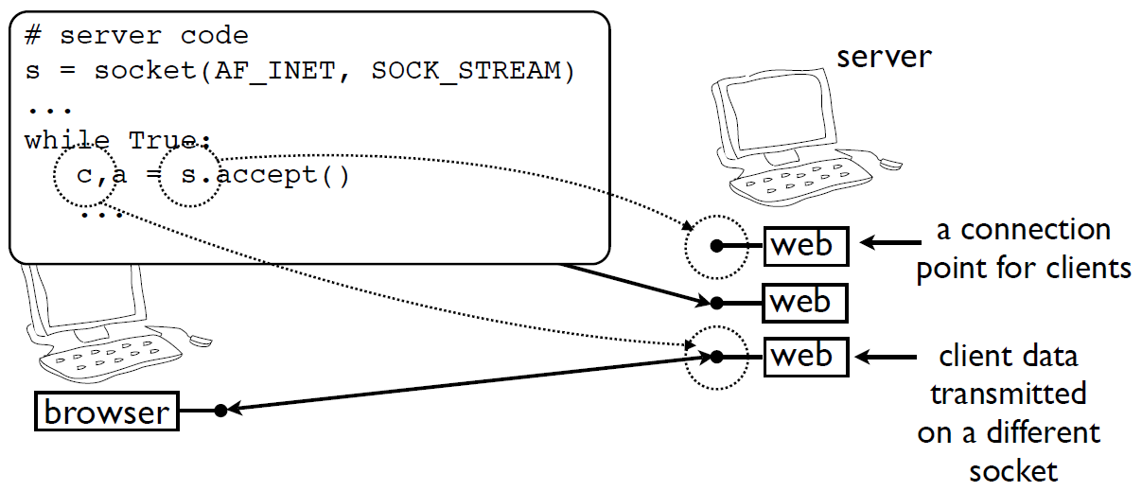
Sockets and Concurrency
Each client gets its own socket on the server

Slide 70
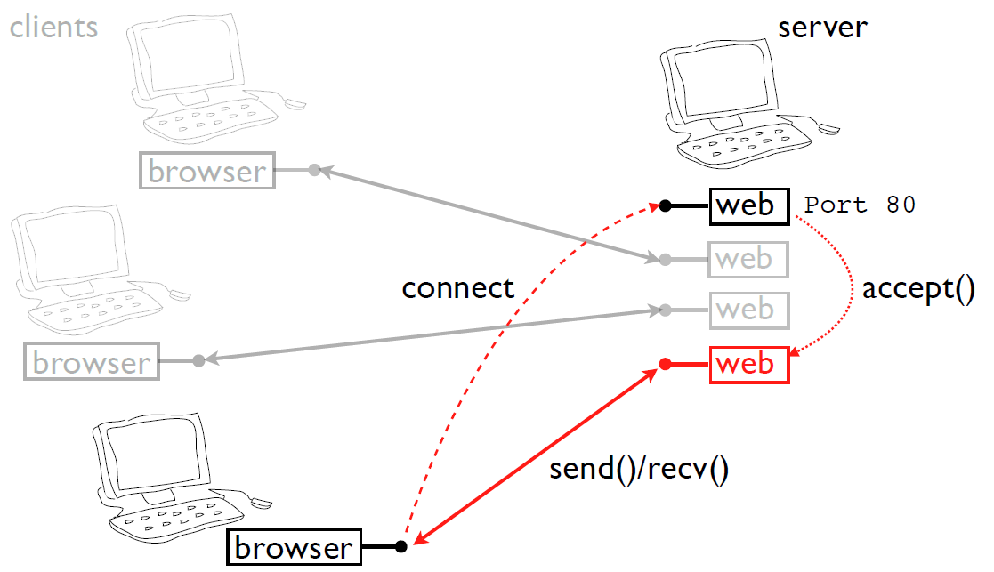
Sockets and Concurrency
New connections make a new socket

Slide 71
Threaded Server
Each client is handled by a separate thread
import threading
from socket import *
def handle_client(c):
... whatever ...
c.close()
return
s = socket(AF_INET,SOCK_STREAM)
s.bind(("",9000))
s.listen(5)
while True:
c,a = s.accept()
t = threading.Thread(target=handle_client,
args=(c,))

Slide 72
Forking Server
Each client is handled by a subprocess
import os
from socket import *
s = socket(AF_INET,SOCK_STREAM)
s.bind(("",9000))
s.listen(5)
while True:
c,a = s.accept()
if os.fork() == 0:
# Child process. Manage client
...
c.close()
os._exit(0)
else:
# Parent process. Clean up and go
# back to wait for more connections
c.close()
Note that some critical details have been omitted

Slide 73
Asynchronous Server
Server handles all clients in an event loop
import select
from socket import *
s = socket(AF_INET,SOCK_STREAM)
...
clients = [] # List of all active client sockets
while True:
# Look for activity on any of my sockets
input,output,err = select.select(s+clients,
clients, clients)
# Process all sockets with input
for i in input:
...
# Process all sockets ready for output
for o in output:
...

Slide 74
Utility Functions
Get the hostname of the local machine
>>> import socket
>>> socket.gethostname()
'cse04'
>>>
Get the IP address of a remote machine
>>> import socket
>>> socket.gethostbyname("www.unt.edu")
'129.120.231.230'
>>>
Get name information on a remote IP
>>> import socket
>>> socket.gethostbyaddr("129.120.151.98")
('cse05.cse.unt.edu', ['cse05'], ['129.120.151.98'])
>>>

